Slide 1
Moraga School District Measure V Planning
Citizen Bond Oversight Committee – Site Inspection Subcommittee Report
October 4, 2018
Safe, Functional, Modern Learning Environments
Enhanced Learning
Environment
Safety
Infrastructure
Notes:
Welcome Rich Dunlap RGM and Zach Goodman, Arch with CSDA
Meeting Goal – Informational Update on Progress for Schematics Designs – including budget/cost estimate and scope
I’m going to briefly bring you up to speed on progress since the last Board presentation in February. Thank you for meeting -

Slide 2
Quick Start Projects
Site Inspection Date and Time | Site inspection Location & Project Date
September 27, 2017 | LP playground/resurface (Summer of 17)
September 27, 2017 | CP retaining wall (Summer of 17)
October 7 and 15, 2017 | JM, Bldg G (Winter 17/18)
October 2, 2018 | CP tables and benches (Summer of 18)
October 2, 2018 | DR tables and benches (Summer of 18)
October 2, 2018 | LP tables and benches (Summer of 18)
October 2, 2018 | CP two retaining walls (Summer of 18)
October 2, 2018 | LP two retaining walls (Summer of 18)
October 2, 2018 | JM playground (Summer of 18)

Slide 3
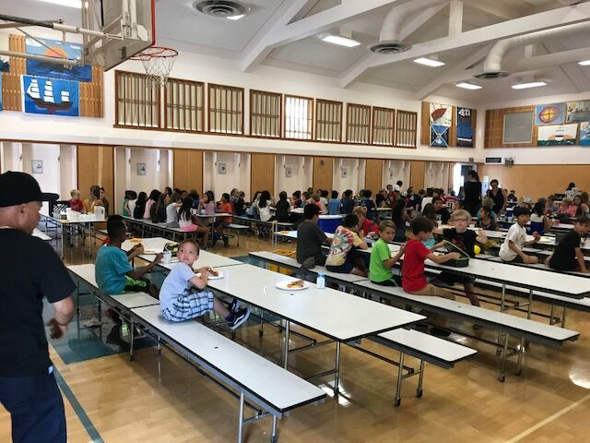
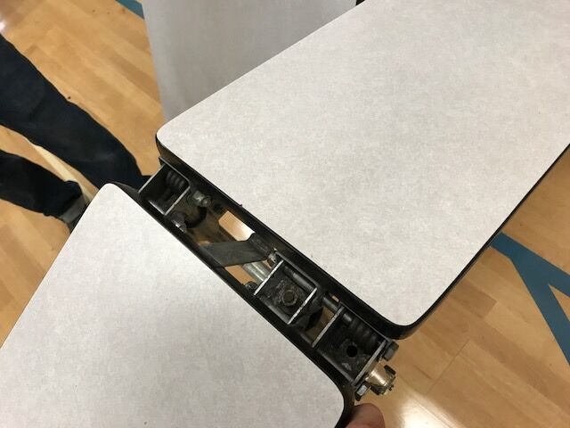
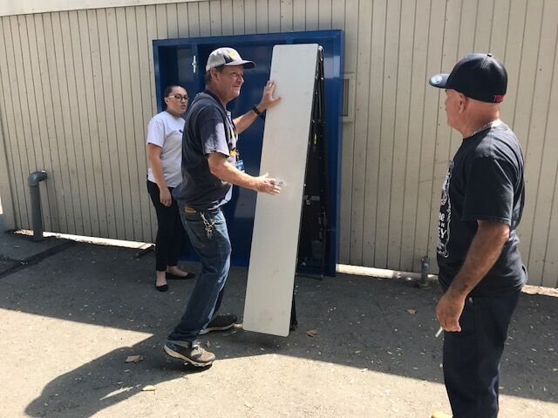
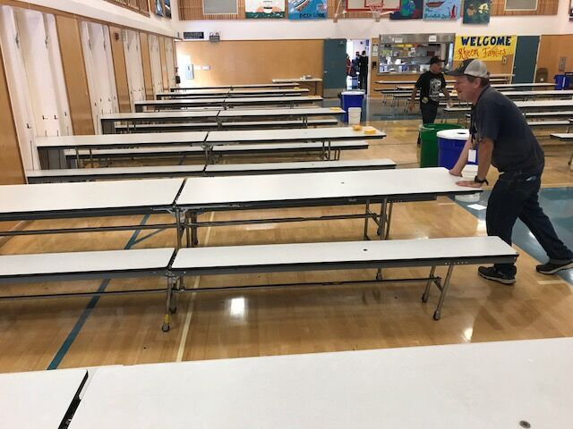
New Elem MUR Tables and benches
Before
Enhanced Learning Environment
Safety
Infrastructure

Slide 4
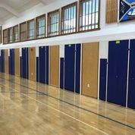
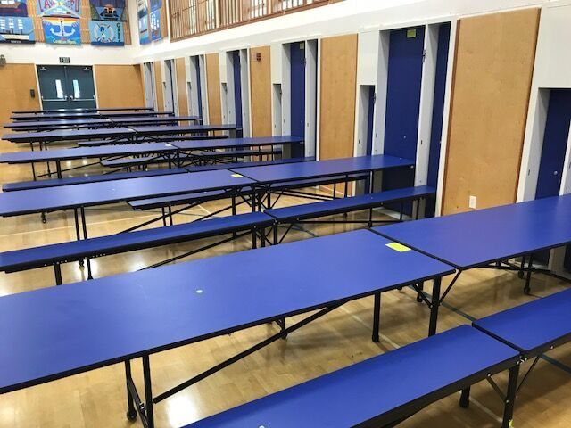
New Elem MUR Tables and benches
AFTER
Enhanced Learning Environment
Safety
Infrastructure

Slide 5
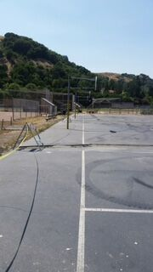
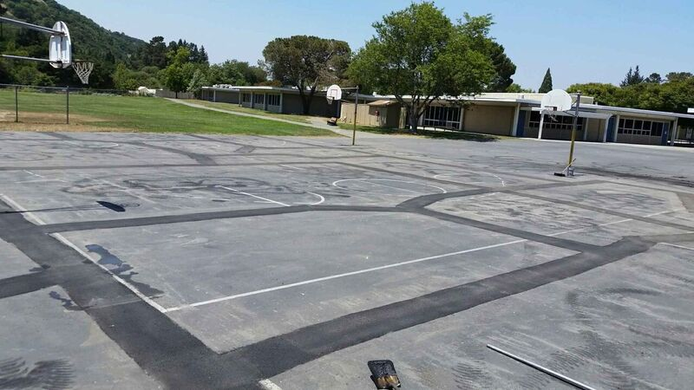
JMIS Playground – Slurry/SEAL
Before
Enhanced Learning Environment
Safety
Infrastructure

Slide 6
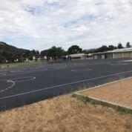
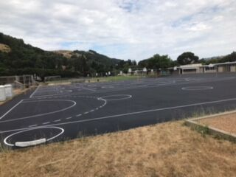
JMIS Playground – Slurry/SEAL
after
Enhanced Learning Environment
Safety
Infrastructure

Slide 7
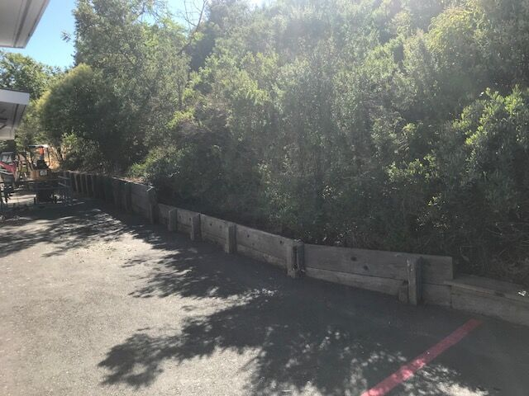
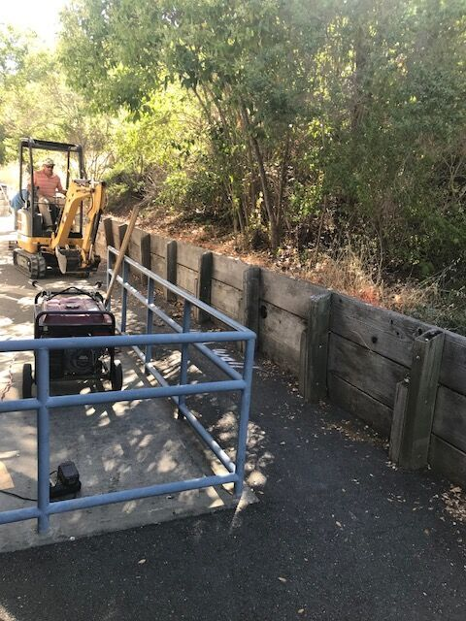
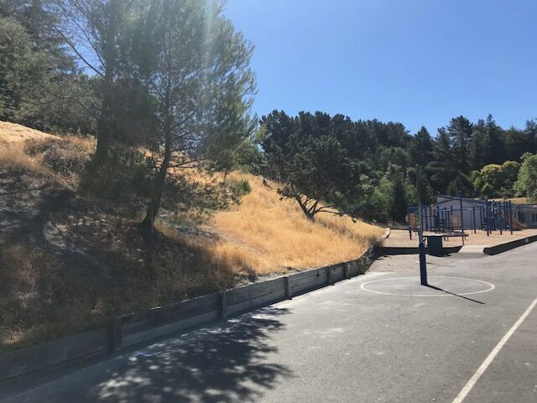
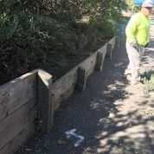
CP Block Seat Walls
Before
Enhanced Learning Environment
Safety
Infrastructure

Slide 8
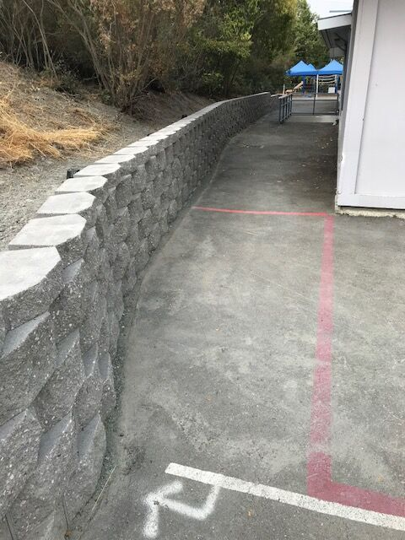
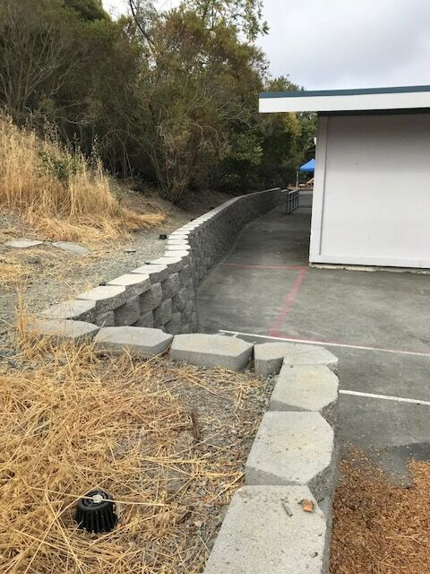
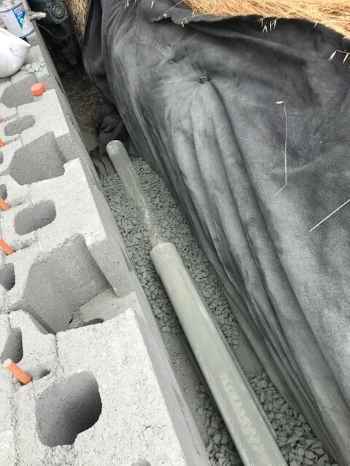
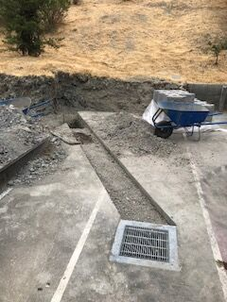
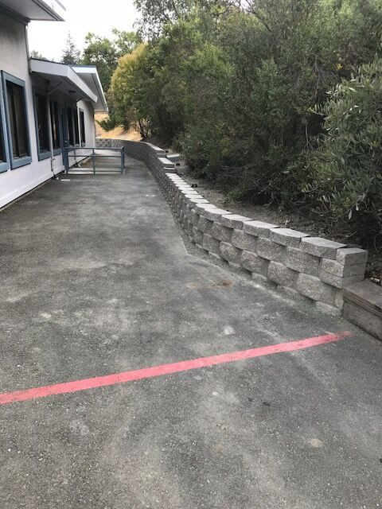
CP Block Seat Walls
after
Enhanced Learning Environment
Safety
Infrastructure

Slide 9
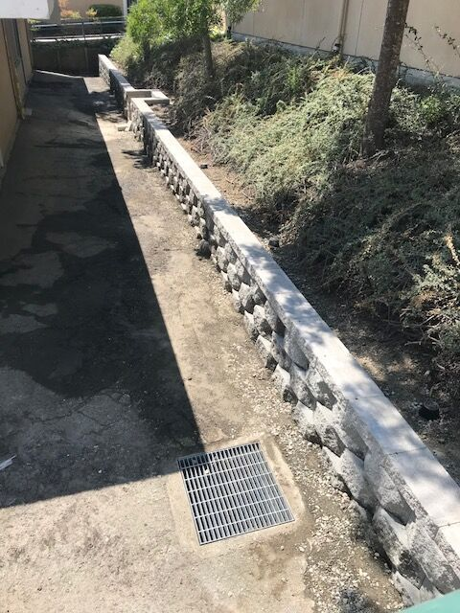
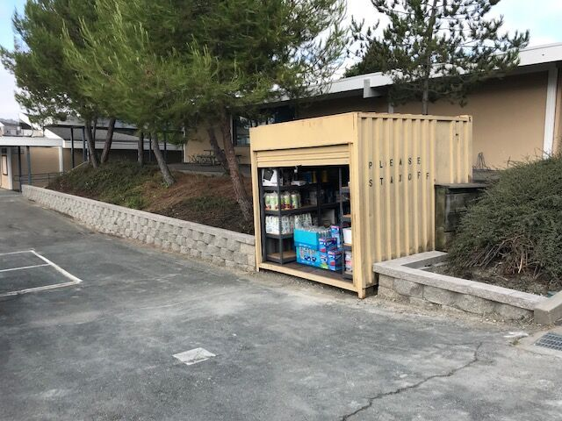
LP Block Seat Walls
after
Enhanced Learning Environment
Safety
Infrastructure

